Slide 1
Automation with SQL, PowerShell, & Interactive Notebooks
Mike Nelson
Solutions Architect
Pure Storage

Slide 2

APIs and SDKs
Interactive Notebooks & Snippets

Slide 3








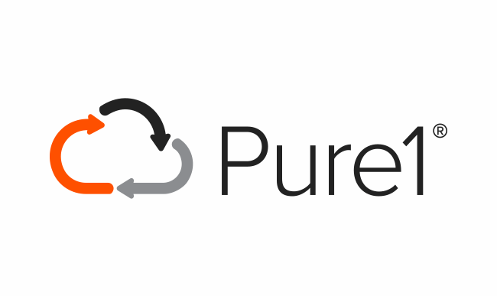






OPEN STANDARDS
API DRIVEN ARCHITECTURE TO SUPPORT SIMPLIFIED INTEGRATION AND MACHINE BASED MANAGEMENT
API Driven
DevOps Integrated
Windows PowerShell
SMI-S

Slide 4

The APIs
FlashArray
FlashBlade
Pure1
…

Slide 5
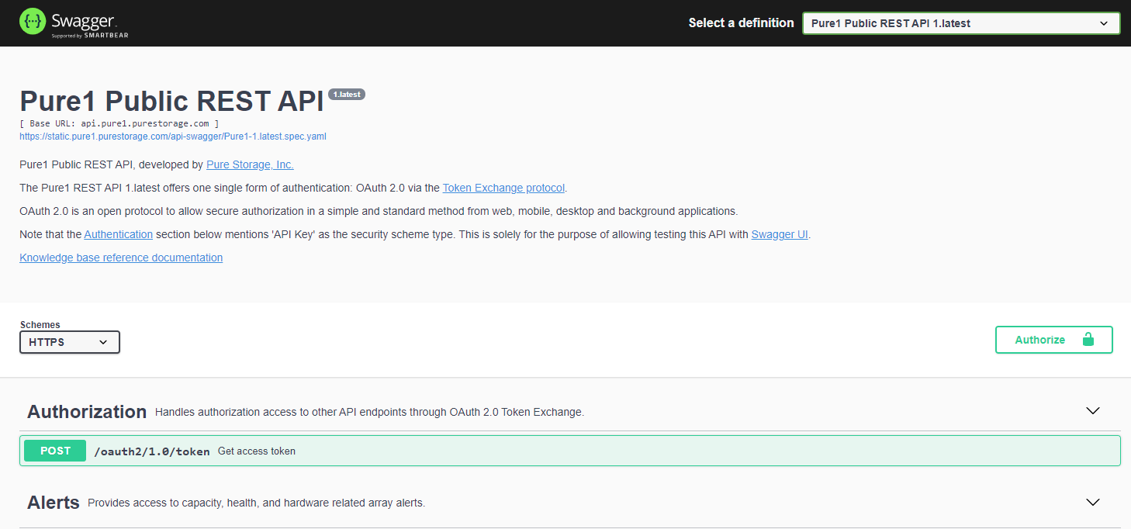
In-product, online, & docker container

Slide 6
The SDKs
PowerShell
Python
Ruby
Go
Unified
… more coming

Slide 7
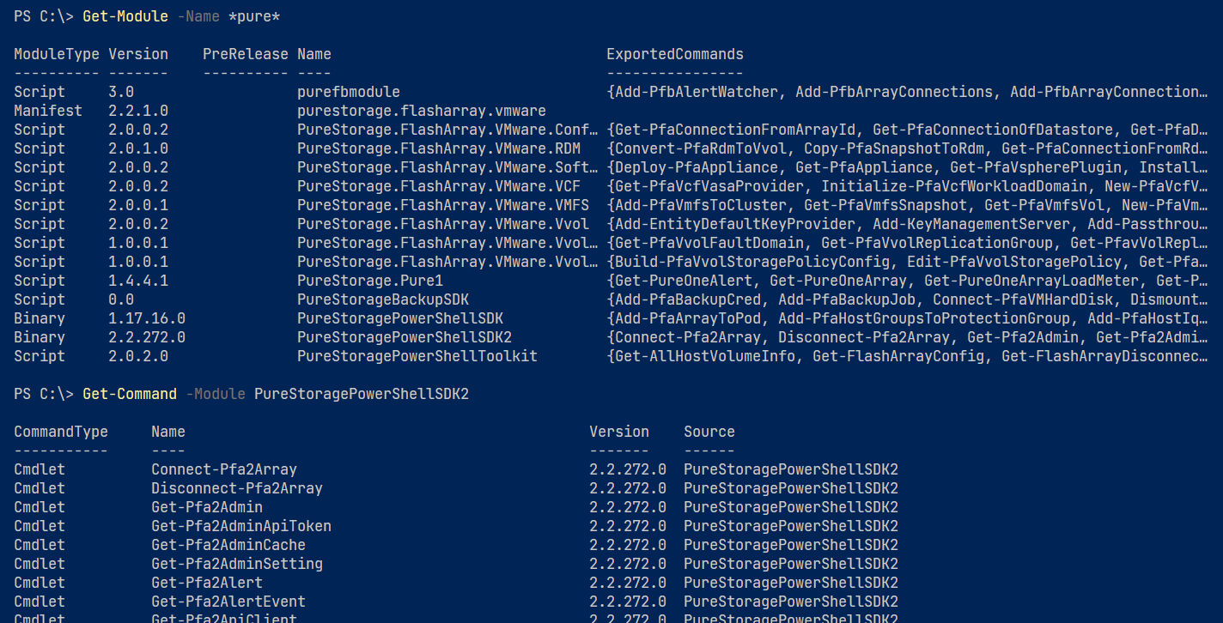

Slide 8

SDK Timeline
1.5.5.1
1.13.0.3
1.16.6.0
1.17.3.0
02
05
07
08
2.2.272.0
The Idea
1.6.6.0
1.7.4.0
1.13.1.12
01
03
04
06
2015
July 2016
Oct 2016
Feb 2017
May 2018
June 2018
Aug 2019
April 2020
Aug 2020

Slide 9
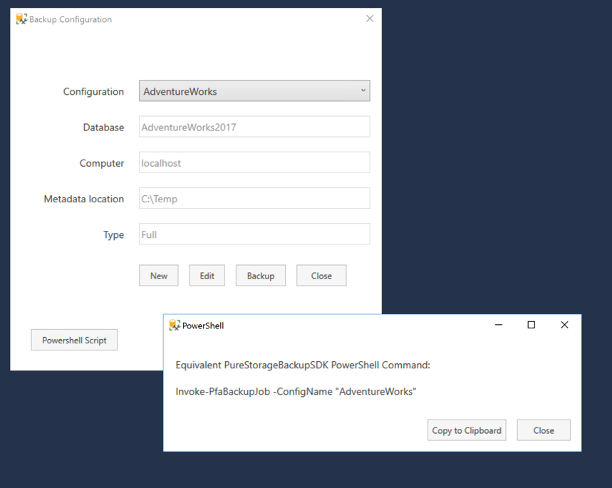
SQL BackupSDK
PureStorageBackupSDK
PowerShell Script button
Restore Restore-PfaBackupJob -HistoryId 1 Dismount Dismount-PfaBackupJob -HistoryId 1 Remove Remove-PfaBackupHistory -HistoryId 1
Creating new backup configurations
Add-PfaBackupJob -ConfigName ”<ConfigName>" ` -Component ”<DBName>" -MetadataDir "C:\Temp” ` -ComputerName "localhost" –FAName ` ”<FlashArrayName>"

Slide 10
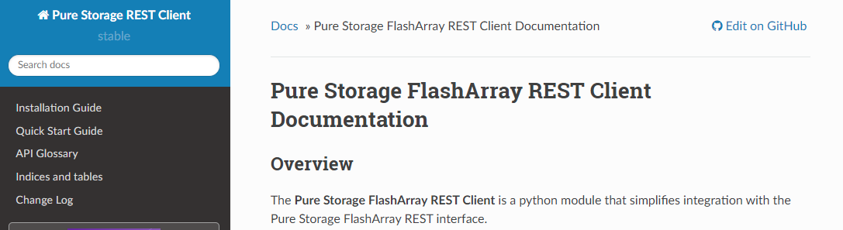
FlashArray Python SDK

Slide 11
Pure1 SDK
https://static.pure1.purestorage.com/api-swagger

Slide 12
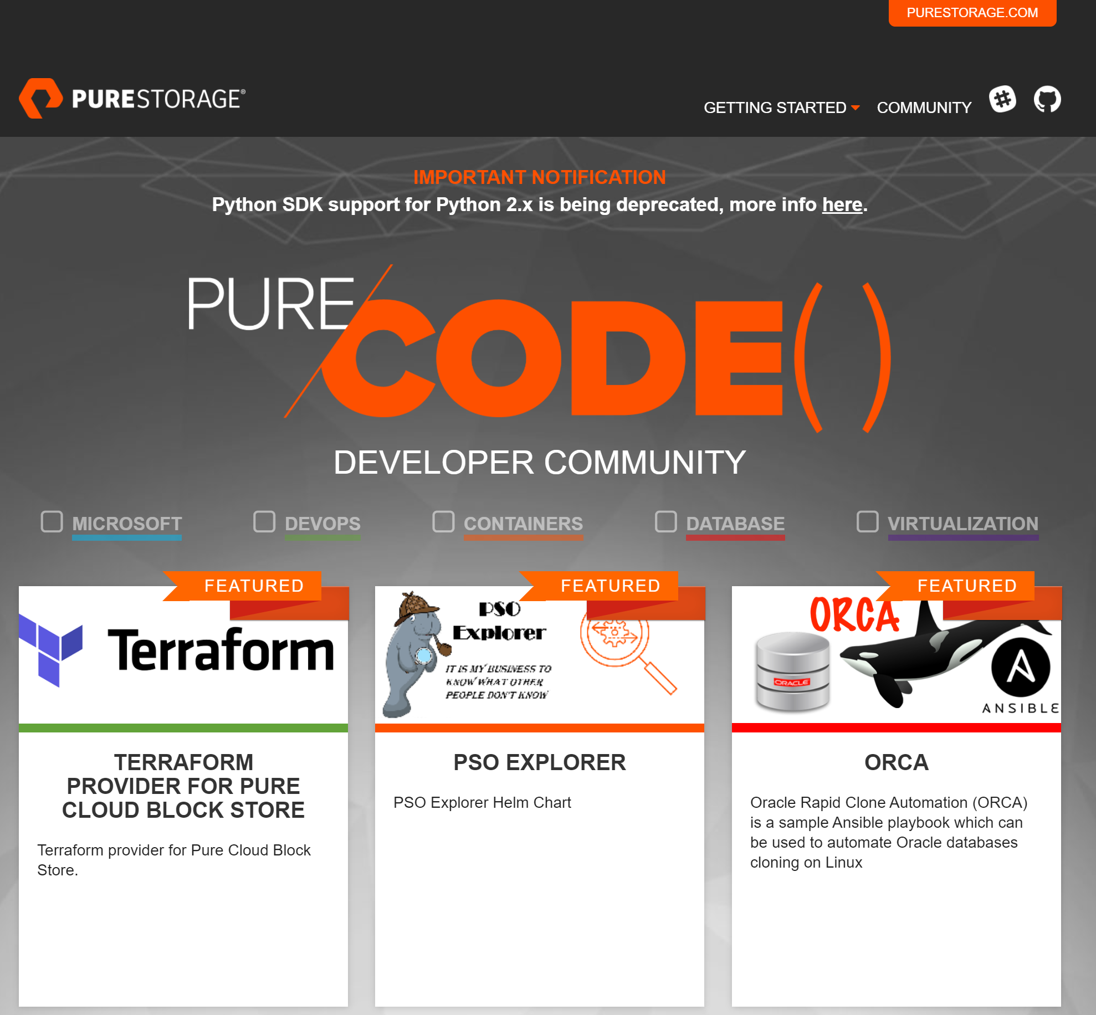
Pure/Code() PureStorage-Connect PureStorage-OpenConnect PureStorage-PartnerConnect

Slide 13
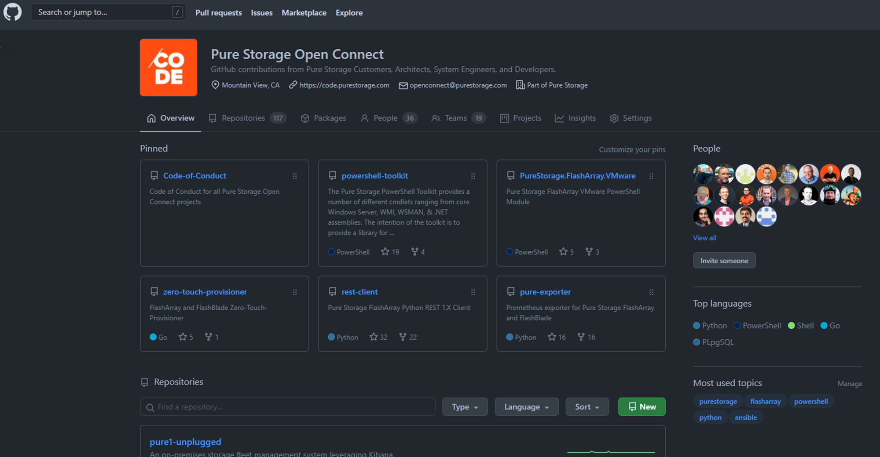

Slide 14


PowerShell Toolkits

Slide 15
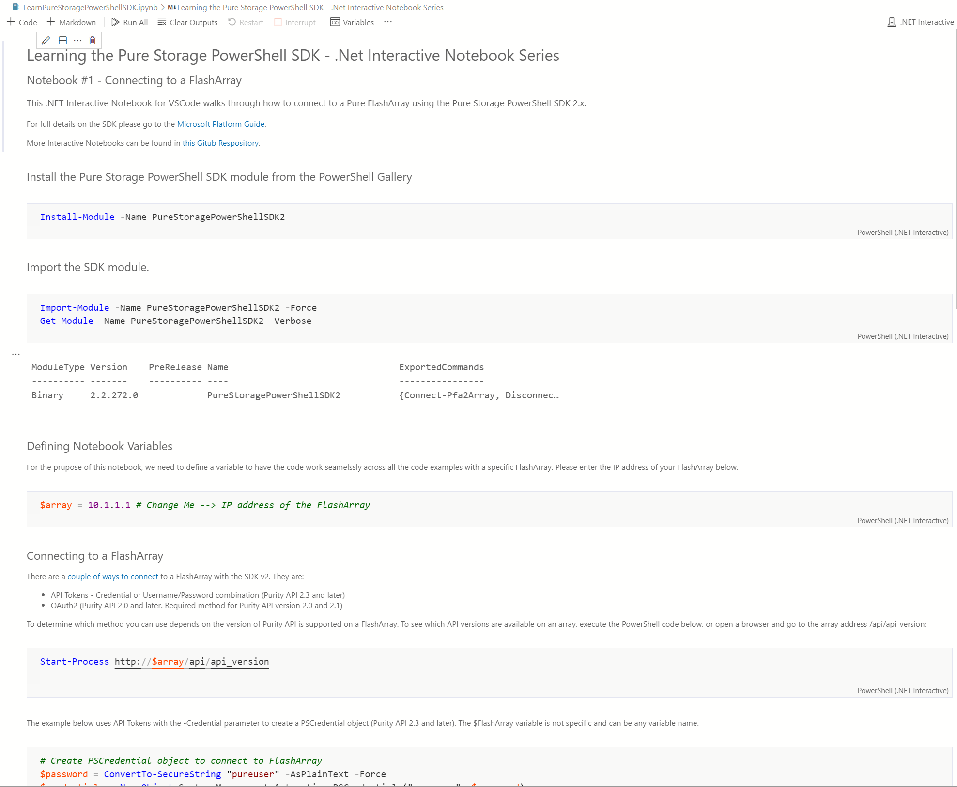

Slide 16
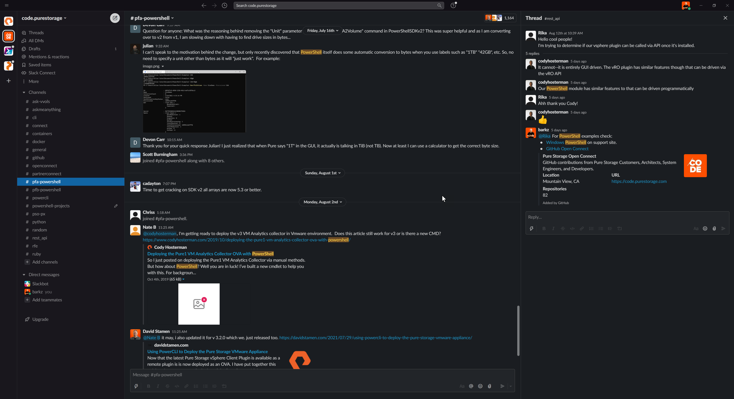
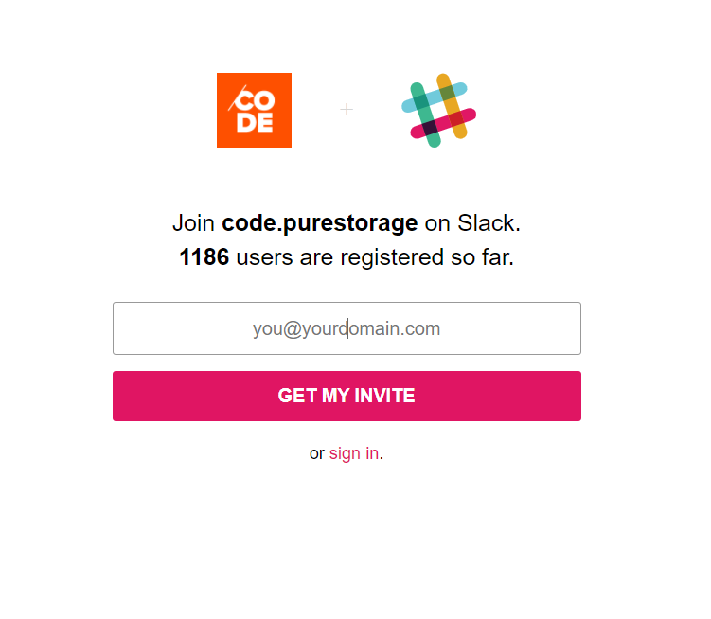

Slide 17
PowerShell & more…

Slide 18



Contact Us!
codeinvite.purestorage.com
fasolutions@purestorage.com

Slide 19

Special Thanks To
for supporting
DataPlatformGeeks & SQLServerGeeks
Community Initiatives

Slide 20

Thank You
Three Ways to Win Prizes
Post your selfie with hash tag #DPS2021
Give Session & Conference Feedback
Visit our Sponsors & Exhibitors
Follow us on Twitter @TheDataGeeks @DataAISummit

